Slide 1
Foundation of computer science
By : Mohamed Agami

Slide 2

Lecture 7
Motherboard part 4

Slide 3
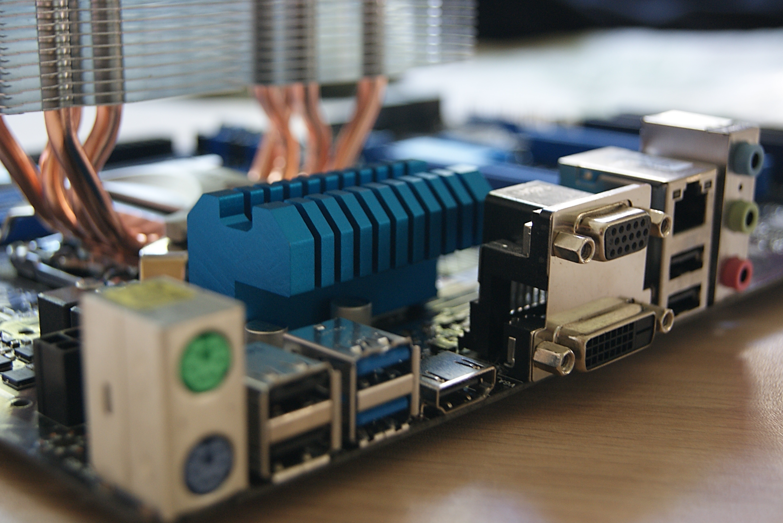
Onboard Ports & Connectors

Slide 4
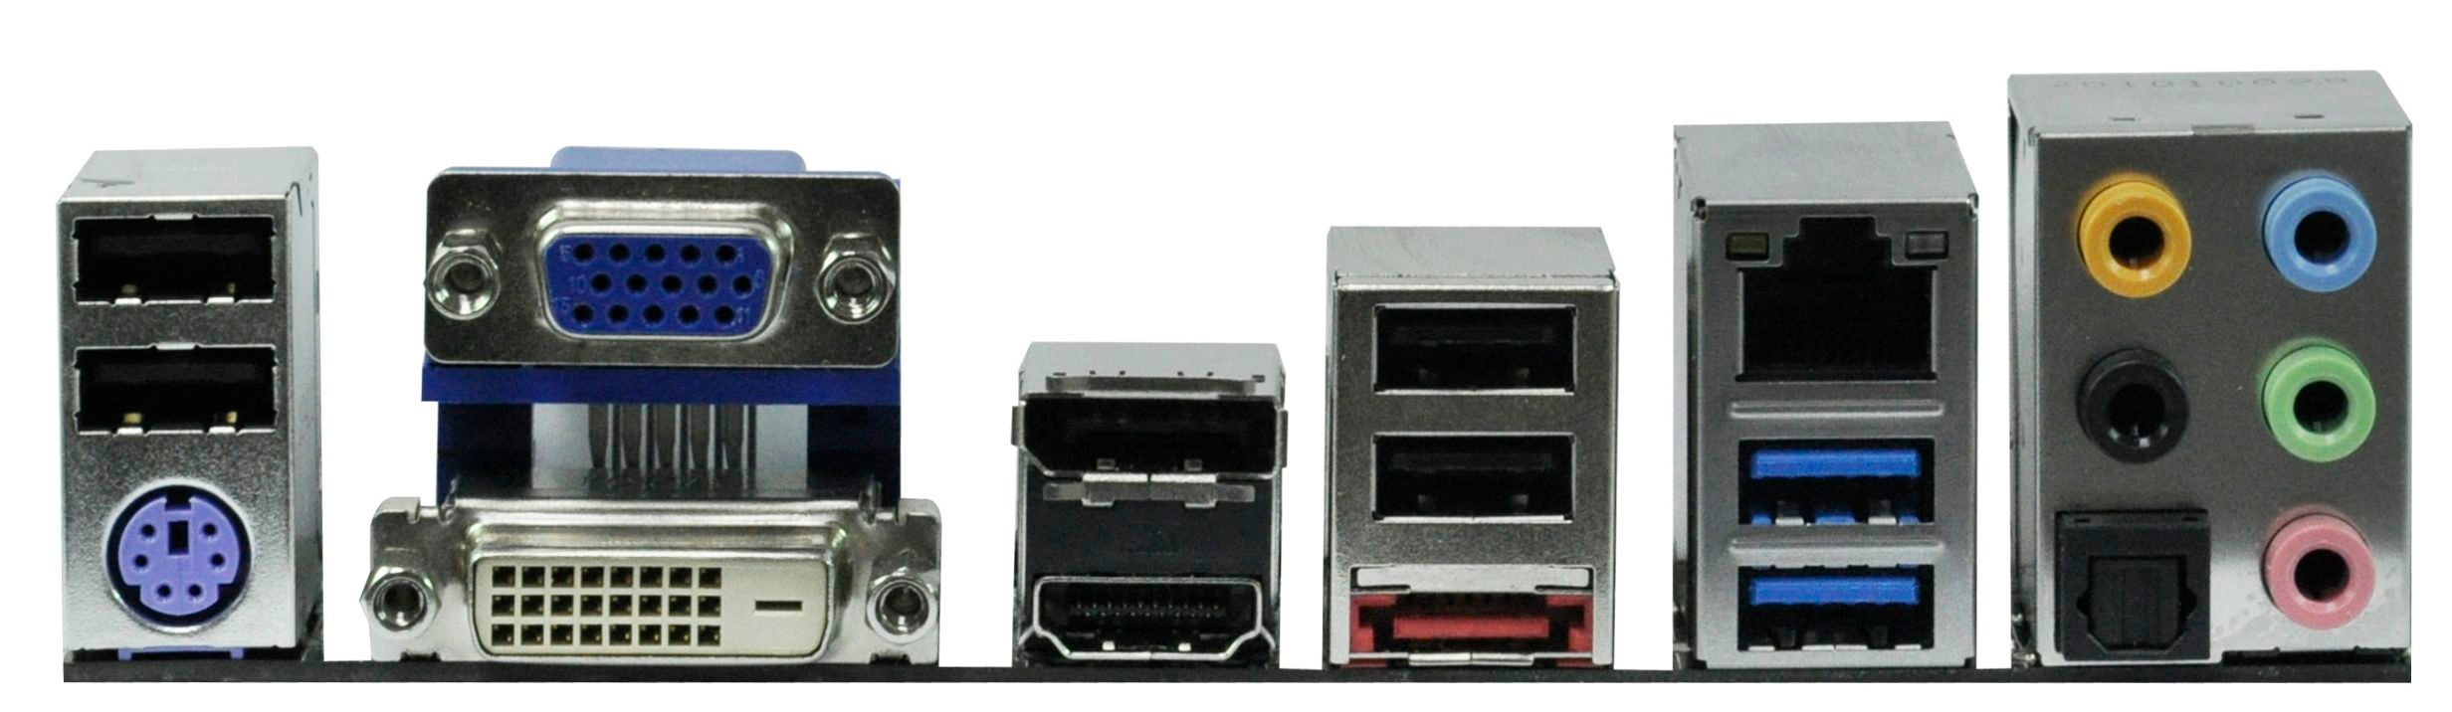
USB 2.0
VGA
RJ45
USB 2.0
Display Port
PS2
DVI
HDMI Port
eSATA
USB 3
Sound Ports

Slide 5

Major Manufacturers Of Motherboards

Slide 6
Company Name | Year of Establishment | Market Share Percentage | Official Website
ASUS | 1989 | 35% | https://www.asus.com/
MSI | 1986 | 15% | https://www.msi.com/
Gigabyte | 1986 | 25% | https://www.gigabyte.com/
ASRock | 2002 | 13% | https://www.asrock.com/
Biostar | 1986 | 5% | https://www.biostar.com.tw/

Slide 7

Tank you

